Slide 1
Module 1
Exploring ASP.NET Core MVC
Notes:
Module 1 is intended to orient the students by providing an overview of Microsoft web technologies and the web stack. It also provides greater detail on ASP.NET Core MVC. As you teach this module, remember that many subjects are covered in greater detail only later in the course.
20486D
01: Exploring ASP.NET Core MVC

Slide 2
Module Overview
Overview of Microsoft Web Technologies Overview of ASP.NET 4.x Introduction to ASP.NET Core MVC
Notes:
In this module, the students might see technologies and terms that are not fully clear to them. Explain to the students that the reason for this is that this module is only an overview and that many subjects will be explained in detail in the next modules.
20486D
01: Exploring ASP.NET Core MVC

Slide 3
Lesson 1: Overview of Microsoft Web Technologies
Introduction to Microsoft Web Technologies Overview of ASP.NET Client-Side Web Technologies Hosting Technologies
Notes:
This lesson provides the students with basic understanding of the Microsoft web stack. The goal is to orient the students to the different technologies they will be using when developing web applications. After completing it, they should be able to distinguish between client and server technologies, and hosting technologies in general. You should introduce each tool without much depth.
20486D
01: Exploring ASP.NET Core MVC

Slide 4
Introduction to Microsoft Web Technologies
Develop
Host
Execute
Server-Side
Server-Side
Client-Side
Client-Side
Visual Studio
Visual Studio Code
IIS
Microsoft Azure
ASP.NET Core
ASP.NET 4.x
JavaScript
jQuery
Angular
React
AJAX
Notes:
This topic is intended to be a high-level overview of the web stack. Use it to orient students and provide quick definitions of all the technologies on the slide. Do not go into depth. If you spend more than the intended five minutes for this topic, you might not be able to complete all the topics in this module within the scheduled time. Tell students that subsequent topics and modules provide full details.
Throughout the course, students will use Visual Studio to build web applications. Even though they can use Visual Studio Code, we will focus solely on Visual Studio 2017.
20486D
01: Exploring ASP.NET Core MVC

Slide 5

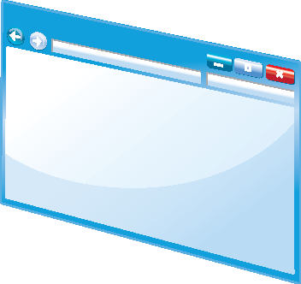


Overview of ASP.NET
Programming Models:
ASP.NET 4.x:
Web Pages
Web Forms
ASP.NET 4.x and ASP.NET Core:
MVC
Web API
ASP.NET Core:
Razor Pages
ASP.NET
HTML
Pages
Notes:
Use this topic as an overview of ASP.NET to orient the students and to introduce key programming models. The programming models will be covered in subsequent lessons of this module.
20486D
01: Exploring ASP.NET Core MVC

Slide 6
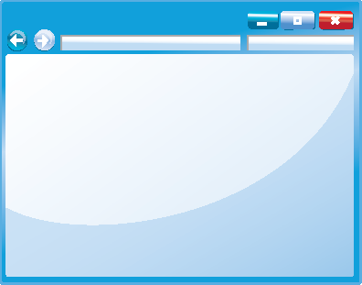


Client-Side Web Technologies
JavaScript
jQuery
AJAX
Angular
React
And more
<p>
Content
</p>
p {
color: black;
}
Notes:
JavaScript lies beneath all the technologies described in this topic. JavaScript exists within HTML pages and can change the styles of elements by using cascading style sheets (CSS) styles and the structure and content of web pages. There are many libraries and frameworks that are built on top of JavaScript such as jQuery, Angular, React, Underscore, and more.
These libraries and frameworks allow you to speed up the development process and create rich web applications.
20486D
01: Exploring ASP.NET Core MVC

Slide 7

Hosting Technologies
IIS
Features
Scaling
Perimeter Networks
IIS Express
Other Web Servers
Notes:
You can find more information about all currently-supported versions and editions of IIS at:
http://go.microsoft.com/fwlink/?LinkID=288942&clcid=0x409
The Apache web server homepage can be found at: http://go.microsoft.com/fwlink/?LinkID=288943&clcid=0x409
20486D
01: Exploring ASP.NET Core MVC

Slide 8

Microsoft Azure
Cloud computing provides scalability, flexibility, security, and reliability
The Microsoft Azure platform includes:
Web Apps
Databases (Azure SQL Database, Cosmos DB)
Virtual Machines
Mobile Apps
Media Services
Notes:
You should ensure you are familiar with the latest features of Microsoft Azure before you teach this topic.You can create a trial Azure user account and use it to create Web apps, databases, and so on. Explore the features of Azure at http://go.microsoft.com/fwlink/?LinkID=288944&clcid=0x409.
20486D
01: Exploring ASP.NET Core MVC

Slide 9
Lesson 2: Overview of ASP.NET 4.x
Overview of Web Pages Overview of Web Forms Overview of MVC Discussion: ASP.NET 4.x Application Scenarios Shared ASP.NET 4.x Features Overview of Web API
Notes:
In this lesson, the students will learn about the different programming models that exist in ASP.NET 4.x such as Web Pages and Web Forms. The students will not learn the ASP.NET 4.x in the rest of the course, and this is the only place that provides an overview of these technologies.
20486D
01: Exploring ASP.NET Core MVC

Slide 10
Overview of Web Pages
Code in .CSHTML files
Precise control over HTML
<h2>Special Offers</h2>
<p>Get the best possible value on Northwind specialty
foods by taking advantage of these offers:</p>
@foreach (var item in offers) {
<div class="offer-card">
<div class="offer-picture">
@if (!String.IsNullOrEmpty(item.PhotoUrl)){
<img src="@Href(item.PhotoUrl) alt="@item.Title" />
}
</div>
</div>
}
Notes:
Web Pages is designed as a simple server-side programming model that is quick to learn. Ensure that you build a simple Web Pages application before you teach this topic so that you can highlight the differences between the programming models.
20486D
01: Exploring ASP.NET Core MVC

Slide 11
Overview of Web Forms
Code in .aspx files and code-behind files
Create a UI by dragging controls onto a page
Controls provide rich properties and events
Bind controls to data
Notes:
Some of your students may be familiar with Web Forms because they have been present since ASP.NET was introduced. If many students are familiar with Web Forms, you may like to structure this topic as a discussion of the key features of this programming model. This will enable you to assess students’ knowledge.
20486D
01: Exploring ASP.NET Core MVC

Slide 12
Overview of MVC
Models encapsulate objects and data
Views generate the user interface
Controllers interact with user actions
Code in .cshtml and .cs files
Precise control of HTML and URLs
Easy to use unit tests
Notes:
If you have many Web Forms developers among your students, you should emphasize the differences between the Web Forms and MVC programming models. For example, mention that there is no toolbox in MVC for building a user interface by dragging controls onto the page as there is in Web Forms. Also, point out that in MVC, each control does not have a set of server-side events that occur in response to user clicks. Instead, you respond by creating controller actions.
20486D
01: Exploring ASP.NET Core MVC

Slide 13
Discussion: ASP.NET 4.x Application Scenarios
Which programming model will you use in the following scenarios? (Choose one of the following in each scenario: MVC, Web Forms, Web Pages)
A database front-end to be hosted on an intranet
An e-commerce site for a large software organization
A website for a small charitable trust
Notes:
Lead the class in a discussion of each scenario. Ensure the students read the full scenario in their student notes. In each case, identify the features of each programming model that make it suitable or unsuitable for the website being discussed.
Database Front-End
The proposed web application can be written in any of the three programming models. However, because you are replicating an existing desktop application written in Visual Studio, your developers may feel most comfortable in working with Web Forms.
E-Commerce Site
Again, it is possible to develop the site in any of the three programming models. However, MVC is the only programming model that is easy to integrate with unit tests and TDD.
Website for a Small Charitable Trust
The site can be developed in any of the three programming models. However, Web Pages is the easiest to learn, and therefore, is most appropriate for a developer with limited experience.
Emphasize to the students that the existing skills and preferences of developers is frequently a key consideration in selecting a programming model.
20486D
01: Exploring ASP.NET Core MVC

Slide 14
Shared ASP.NET 4.x Features
Configuration
Authentication
Membership and Roles
State Management
Caching
Notes:
This is the only place in the course that we discuss ASP.NET 4.x features that are common to all its' programming models. It is recommended to emphasize the difference between ASP.NET 4.x and ASP.NET Core and mention that many of the features discussed here work differently in ASP.NET Core as the students will see in future modules.
20486D
01: Exploring ASP.NET Core MVC

Slide 15
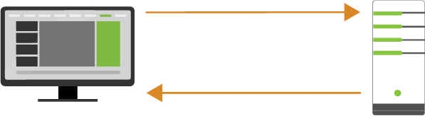
Overview of Web API
Helps creating RESTful APIs
Enables external systems to use your application's business logic
Accessible to various HTTP clients
Helps to obtain data in different formats such as JSON and XML
It supports create, read, update and delete (CRUD) actions
Ideal for mobile application integration
Notes:
Web API is a programming model that might be familiar to the students from other web frameworks and languages that allow creating RESTful APIs such as PHP or Node.js. This topic provides an overview of Web API, but it will be discussed in much more detail in Module 13, “Implementing Web APIs”.
20486D
01: Exploring ASP.NET Core MVC

Slide 16
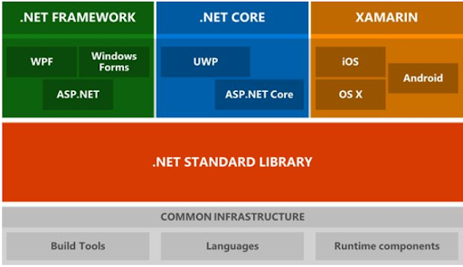
Lesson 3: Introduction to ASP.NET Core MVC
Notes:
In this lesson, the students will see the basics of how ASP.NET Core MVC works and what are the differences between models, views, and controllers. We will also explore how to choose between ASP.NET Core and ASP.NET 4.x. This is the only place in this course where we will explore those differences.
20486D
01: Exploring ASP.NET Core MVC

Slide 17
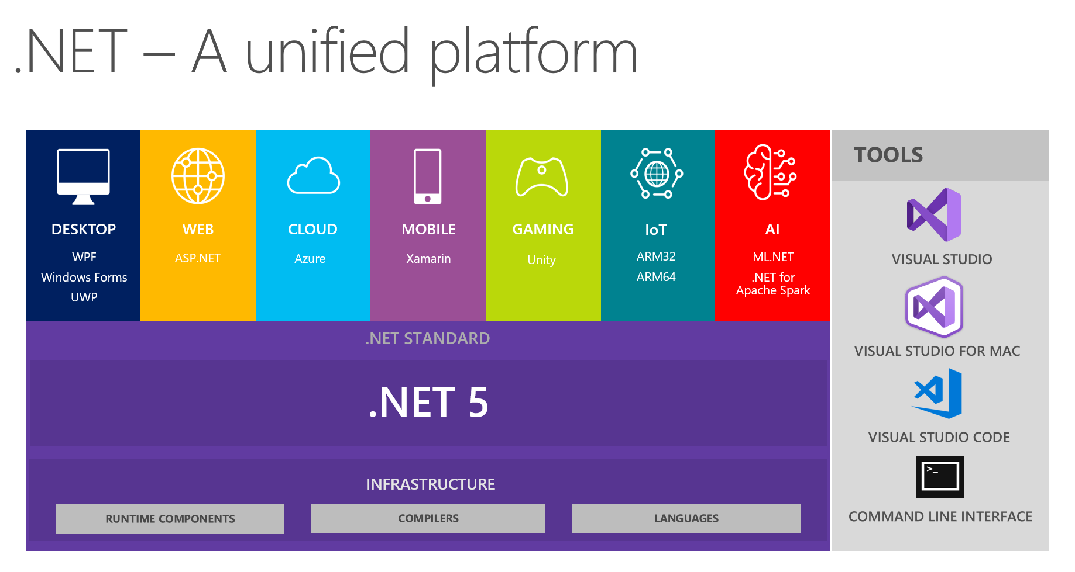
Lesson 3: Introduction to ASP.NET Core MVC
Notes:
In this lesson, the students will see the basics of how ASP.NET Core MVC works and what are the differences between models, views, and controllers. We will also explore how to choose between ASP.NET Core and ASP.NET 4.x. This is the only place in this course where we will explore those differences.
20486D
01: Exploring ASP.NET Core MVC

Slide 18
Lesson 3: Introduction to ASP.NET Core MVC
Introduction to ASP.NET Core Discussion: Choose between ASP.NET 4.x and ASP.NET Core Choose between .NET Core and .NET Framework Models, Views, and Controllers Demonstration: How to Explore an ASP.NET Core MVC Application
Notes:
In this lesson, the students will see the basics of how ASP.NET Core MVC works and what are the differences between models, views, and controllers. We will also explore how to choose between ASP.NET Core and ASP.NET 4.x. This is the only place in this course where we will explore those differences.
20486D
01: Exploring ASP.NET Core MVC

Slide 19
Introduction to ASP.NET Core
ASP.NET Core is:
Modern redesign of ASP.NET 4.x
Cross-platform and open source
Lean, high-performance and modular framework
Cloud-ready
Supports the following programming models:
MVC
Razor pages
Web API
Notes:
This topic gives an overview of ASP.NET Core and covers various programming models in ASP.NET Core. While MVC will be covered in greater detail through this course and Web API will be covered in Module 13, "Implementing Web APIs", this is the only module that covers Razor Pages.
20486D
01: Exploring ASP.NET Core MVC

Slide 20
Razor Pages
Alternative to the MVC programming model
Starts with the @page directive
@page
@model HomePageModel
<h1>@Model.Title</h1>
<h2>@Model.Description</li>
Notes:
The @page directive, which is placed inside the first line of a .cshtml file, turns the file into a Razor Page instead of a view. Each Razor Page file has an accompanying .cshtml.cs file that contains all the methods, model handlers, and logic. This is the place to initialize the model and get data from the database when needed.
20486D
01: Exploring ASP.NET Core MVC

Slide 21
Discussion: Choose between ASP.NET 4.x and ASP.NET Core
Which version of ASP.NET (ASP.NET 4.x or ASP.NET Core) will you use in the following scenarios?
High performing application for the stock market
Update an existing website written in Web Forms
Open-source project running on macOS
Notes:
Lead the class in a discussion of each scenario. Ensure the students read the full scenario in their student notes. In each case, identify the features of each ASP.NET version that makes it suitable or unsuitable for the web application being discussed.
High Performing Application for the Stock Market
The key point in this scenario is that the application must be high performing. Both ASP.NET 4.x and ASP.NET Core are high performing, but ASP.NET Core is slightly better.
Update an Existing Website Written in Web Forms
In this case, you are working on an existing website, built with Web Forms. Web Forms are not supported in ASP.NET Core and for that reason, you can only update to ASP.NET 4.x.
Open Source Project running on macOS
When working on a project that needs to run on various environments such as Windows, macOS, and Linux, ASP.NET Core will be the right choice.
Emphasize to the students that ASP.NET Core will be the natural choice for most new projects. ASP.NET 4.x will be preferred when the web application needs to live in the context of an existing application written in ASP.NET 4.x or that it needs to support features that do not exist in ASP.NET Core, such as Web Forms and Web Pages.
20486D
01: Exploring ASP.NET Core MVC

Slide 22
Choose between .NET Core and .NET Framework
You should use .NET Core when:
You want your code to run cross-platform
You want to create microservices
You want to use Docker containers
You want to achieve a high-preforming scalable system
You should use .NET Framework when:
You want to extend an existing application that uses .NET Framework
You want to use NuGet packages or third-party .NET libraries that are not supported in .NET Core
You want to use .NET technologies that aren't supported in .NET Core
You want to use a platform that doesn’t support .NET Core
Notes:
This slide summarizes the key points discussed in this topic. You should explain in a few words what are microservices and Docker container because the students might not be familiar with those terms.
20486D
01: Exploring ASP.NET Core MVC

Slide 23

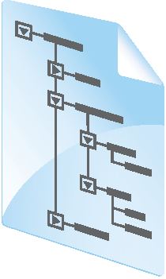


Models, Views, and Controllers
SQL
View
Model
Database
Controller
HTTP
Web Server
Browser
Notes:
Students will learn more about the ASP.NET routing engine in Module 4, “Developing Controllers”.
Students will learn more about Entity Framework in Module 7, “Using Entity Framework Core in ASP.NET Core”.
20486D
01: Exploring ASP.NET Core MVC

Slide 24
Demonstration: How to Explore an ASP.NET Core MVC Application
In this demonstration, you will:
Examine an ASP.NET Core MVC application that renders the default home page
Examine the Index View code
Examine the default route used to map requests to the controller
Examine the Home Controller code
Examine the Photo Model code
Examine the photo list rendered as a result of models, controllers, and views working together
Notes:
The purpose of this demonstration is to orient students within a typical ASP.NET Core MVC application and to illustrate the components of the project. Do not try to demonstrate the entire application or explain concepts that students will see later in the course. Ensure that you make a note of the port number your application uses for debugging, as described in Preparation Steps. Furthermore, make sure you have SQL Server Management with this particular server name - (localdb)\MSSQLLocalDB.
Demonstration Steps
You will find the steps in the “Demonstration: How to Explore an ASP.NET Core MVC Application“ section on the following page: https://github.com/MicrosoftLearning/20486D-DevelopingASPNETMVCWebApplications/blob/master/Instructions/20486D_MOD01_DEMO.md.
20486D
01: Exploring ASP.NET Core MVC

Slide 25
Lab: Exploring ASP.NET Core MVC
Exercise 1: Exploring a Razor Pages Application Exercise 2: Exploring a Web API Application Exercise 3: Exploring an MVC Application
Estimated Time: 90 minutes
Notes:
This lab is intended to show the students the differences and similarities between Razor Pages, Web API, and MVC web applications. In the exercises, the students will create new applications by using each of these programming models. They will add a simple functionality to the applications.
You will find the high-level steps on the following page: https://github.com/MicrosoftLearning/20486D-DevelopingASPNETMVCWebApplications/blob/master/Instructions/20486D_MOD01_LAB_MANUAL.md.
You will find the detailed steps on the following page: https://github.com/MicrosoftLearning/20486D-DevelopingASPNETMVCWebApplications/blob/master/Instructions/20486D_MOD01_LAK.md.
Exercise 1: Exploring a Razor Pages Application
In this exercise, you will create a simple Razor Pages application, and explore its structure.
The main tasks for this exercise are as follows:
Creating a Razor Pages application
Exploring the application structure
Adding simple functionality
Running the application
Exercise 2: Exploring a Web API Application
In this exercise, you will create a simple Web API application, and explore its structure.
The main tasks for this exercise are as follows:
Creating a Web API application
Exploring the application structure
Adding simple functionality
Running the application
20486D
01: Exploring ASP.NET Core MVC
(More notes on the next slide)

Slide 26
Notes:
Exercise 3: Exploring an MVC Application
In this exercise, you will create a simple MVC application, and explore its structure.
The main tasks for this exercise are as follows:
Creating an MVC application
Explore the application structure
Add simple functionality
Run the application
20486D
01: Exploring ASP.NET Core MVC

Slide 27
Lab Scenario
You are working as a junior developer at Adventure Works. You have been asked by a senior developer to investigate the possibility of creating a web-based ASP.NET Core MVC application for your organization's customers, similar to the one that the senior developer has seen on the internet. Such an application will promote a community of cyclists who use Adventure Works equipment, and the community members will be able to share their experiences. This initiative is intended to increase the popularity of Adventure Works Cycles, and thereby to increase their sales. You have been asked to begin the planning of the application. You have also been asked to examine programming models available to ASP.NET Core developers. To do this, you need to create basic web applications using three different models: Razor Pages, Web API, and MVC.
Notes:
This lab is intended to show the students the differences and similarities between Razor Pages, Web API, and MVC web applications. In the exercises, the students will create new applications by using each of these programming models. They will add a simple functionality to the applications.
You will find the high-level steps on the following page: https://github.com/MicrosoftLearning/20486D-DevelopingASPNETMVCWebApplications/blob/master/Instructions/20486D_MOD01_LAB_MANUAL.md.
You will find the detailed steps on the following page: https://github.com/MicrosoftLearning/20486D-DevelopingASPNETMVCWebApplications/blob/master/Instructions/20486D_MOD01_LAK.md.
20486D
01: Exploring ASP.NET Core MVC

Slide 28
Lab Review
Which of the three programming models has the simplest method of applying a single layout across multiple pages? A member of your team replaced the line return View(model); in the Details action of the AnimalController class with the line return View();. What will happen when the Details action is called? When you run the CakeStoreApi application, the browser displays value1 and value2. You want to display your first name and your last name instead. What will you have to do to achieve your goal?
Notes:
Question
Which of the three programming models has the simplest method of applying a single layout across multiple pages?
Answer
Razor Pages and MVC use the same method of applying a single layout across multiple pages. By convention, a file named _Layout.cshtml stores the layout. A single _ViewStart.cshtml file can be used to specify a layout for all pages in the application.
On the other hand, Web API doesn’t have any UI functionality and doesn’t have any method of applying a single layout across multiple pages. In Web API you create HTTP services. If you want to add a UI you should combine Web API with another programming model that has UI functionality.
Question
A member of your team replaced the line return View(model); in the Details action of the AnimalController class with the line return View();. What will happen when the Details action is called?
Answer
Since the view expects a parameter of type Animal, and such parameter is not provided, an exception will be thrown in the Details.cshtml file.
Question
When you run the CakeStoreApi application, the browser displays value1 and value2. You want to display your first name and your last name instead. What will you have to do to achieve your goal?
Answer
You should change the Get method of the ValuesController class, and instead of the string value1, type your first name, and instead of the string value2 type your last name. To see the result, you should run the application.
20486D
01: Exploring ASP.NET Core MVC

Slide 29
Module Review and Takeaways
Review Questions Best Practices Common Issues and Troubleshooting Tips
Notes:
Review Questions
Question
What is the main difference between Razor Pages and MVC?
Answer
The main difference is the programming model. In Razor Pages, the model and the controller are included in the Razor Pages classes and the request goes straight to the page. On the other hand, MVC programming model separates the code into models, views, and controllers.
Question
Which of the application programming models will you recommend for the organization`s customers: Razor Pages, Web API, or MVC?
Answer
Opinions may vary. The aspects of Razor pages, Web API, and MVC programming models you have seen in this module can help determine which model you should use to develop the application. You know that Razor Pages and MVC applications provide precise control over the rendered HTML, which would be helpful in a graphic-driven website. In addition, in MVC applications, the separation of business logic, user interface elements, and input logic will be useful in a complex application. Web API is used to create RESTful APIs that are accessed by using AJAX technology and it is very popular with SPAs. If you intend to create an SPA application, Web API might be the choice.
The programming model should be chosen according to the website’s requirements. However, you must also consider the skills of your team of developers before you choose a programming model.
20486D
01: Exploring ASP.NET Core MVC
(More notes on the next slide)

Slide 30
Notes:
Best Practices
Use Web API when you want to create HTTP services and to allow developers access specific sets of data or functionality of your application. If you would like to add a UI, you should combine Web API with another programming model that has UI functionality.
Use MVC when you want the most precise control over HTML and URLs, when you want to cleanly separate business logic, user interface code, and input logic, or when you want to perform TDD.
Common Issues and Troubleshooting Tips
Common Issue: You add a new view to an MVC application, but when you try to access the page, you receive an HTTP 404 error.
Troubleshooting Tip: In MVC, views cannot function without controller actions. To use the new view, you must add a controller action that returns that view.
Additional Reading: For more information about ASP.NET, including forums, blogs, and third-party tools, visit the official ASP.NET site: http://go.microsoft.com/fwlink/?LinkID=293681&clcid=0x409
Note: Ensure that you cover the common issues and the corresponding troubleshooting tips listed in this section. Encourage students to share tips from their own work environments.
20486D
01: Exploring ASP.NET Core MVC

